Slide 1
Building extraction and roof type classification of aerial images for maximal PV panel installation
FINAL YEAR PROJECT 2021-2022
TEAM 18
PROJECT GUIDE
Prof Dr. P. Uma Maheswari
TEAM MEMBERS
Shruthi M - 2018103592
Gayathri M - 2018103535
Jayapriya M - 2018103029

Slide 2
OVERALL OBJECTIVES
To simulate the placement of PV panels on rooftop of buildings from aerial images based on roof type for maximum energy consumption, the following steps are to be performed:
To segment and detect buildings in a given satellite image using MultiRes UNet model and perform background subtraction to extract the rooftops.
To label the extracted building rooftops into different classes - flat, gable, and hip and create a dataset.
To train convolutional neural nets and transfer learning models for roof type classification and perform a comparative study.
To perform edge detection on the extracted rooftops and mark boundaries to provide a modular layout of PV panel simulation.

Slide 3
INTRODUCTION
Climate change has become a global concern and harnessing renewable resources is the way to construct a sustainable environment. Potential tapping of solar power for generating electricity has gained enormous popularity and people are increasingly gravitating toward the PV revolution.
However, traditional approaches, such as online assessment of rooftops are time-consuming and expensive. By automating the process of building roof extraction for PV panel placement, a lot of money and time can be saved.
A 3-step mechanism is proposed as a solution to address this. We use the AIRS dataset that provides a wide coverage of aerial imagery of Christchurch with 7.5 cm resolution for this purpose.
The first stage is building detection from aerial satellite images. We propose a deep learning framework called MultiRes UNet, with ResPath skip connections between the encoder and decoder structure. Better segmentation of buildings leads to maximum solar potential of rooftop areas.
This is followed by rooftop classification from the extracted buildings with different SOTA models as roof classification is used in new building design, retrofitting existing roofs, and efficient solar integration on building rooftops.
Finally, a simulation of modular layout of PV panels is produced considering the type of roofs, the tilt angle, length and width as provided by the user.

Slide 4
LITERATURE SURVEY
S.NO | CITATION | METHODOLOGY | ADVANTAGES | LIMITATION
1. | An aerial image segmentation approach based on enhanced multi-scale convolutional neural network, 2019 Xiang Li, Yuchen Jiang, Hu Peng and Shen Yin in 2019 IEEE International Conference on Industrial Cyber Physical Systems (ICPS) | 1. Segmentation model is performed using an encoder-decoder architecture. 2. A U-Net is constructed as the main network, and the bottom convolution layer of U-Net is replaced by a set of cascaded dilated convolution with different dilation rates. 3. Add an auxiliary loss function after the cascaded dilated convolution. | 1. From the aspect of design and training, the approach does not involve manual features and does not require specific preprocessing or post-processing, which can reduce the influence of subjective factors. 2. The auxiliary loss function helps to make the network converge faster and optimize. | 1. Segmentation of large buildings work well but boundaries are misaligned. 2. The bulges on the boundaries are lost and edges are not detected properly. 3. The algorithm performs well in one of the subset (countryside and forest) but does not perform well when tested on a different subset.

Slide 5
LITERATURE SURVEY
S.NO | CITATION | METHODOLOGY | ADVANTAGES | LIMITATION
2. | Deep learning based roof type classification using very high resolution aerial imagery, 2021 M. Buyukdemircioglu , R. Can , S. Kocaman in The International Archives of the Photogrammetry, Remote Sensing and Spatial Information Sciences, Volume XLIII-B3-2021 XXIV ISPRS Congress | 1. Using UltraCam Falcon large-format digital camera orthophotos with 10cm spatial resolution is captured and roofs are manually classified into 6 different labels. 2. Data augmentation is applied and a shallow CNN architecture is trained. 3. The prediction is investigated by comparing with three different pre-trained CNN models, i.e. VGG-16, EfficientNetB4, and ResNet-50. | 1. Simple CNN model are hence easier to implement. 2. Requires nominal hardware specifications. 3. The shallow CNN model has achieved 80% accuracy. | 1. Since the roof images were clipped automatically from the orthophotos, there are few buildings with overlap. 2. Half-hip roofs are not classified properly and F1 score obtained for them is very low. 3. Different hyperparameter tuning was not done for the shallow CNN architecture.

Slide 6
LITERATURE SURVEY
S.NO | CITATION | METHODOLOGY | ADVANTAGES | LIMITATION
3. | Deep Convolutional Neural Network Application on Rooftop Detection for Aerial Imagery, 2019 Mengge Chen, Jonathan Li, in Journal of Computational Vision and Imaging Systems | 1. It is primarily based on Mask R-CNN with 3 stages. 2. Feature extraction is based on existing deep learning model. 3. RPN (Regional Proposal Network) is used to find RoI. 4. Object classification is then performed. | 1. Efficient and feasible approach to extract detached house from aerial images. 2. RoIAlign method is used instead of RoIPool for better feature extraction. | 1. Training data was less and hence less accuray. 2. Edges of the building are not detected properly. 3. Comparatively less precision with other new state of art models.
4. | Solar Potential Analysis Of Rooftops Using Satellite Imagery, 2019 Akash Kumar, Delhi Technology University, in ArXiv abs/1812.11606 | 1. Dataset is manually collected for India. 2. Adaptive Edge Detection and Contours are focused to segment out rooftop boundaries and obstacles present inside them along with polygon shape approximation. | 1.Provides a comparative analysis of the solar potential of the building. 2. Several types of the rooftop are considered to learn the intra-class variations. | 1. The resolution of satellite image is very poor hence segmentation is not done properly. 2. There are some outliers that are plotting solar panels outside the building rooftop area.

Slide 7
LITERATURE SURVEY
S.NO | CITATION | METHODOLOGY | ADVANTAGES | LIMITATION
5. | Understanding rooftop PV panel semantic segmentation of satellite and aerial images for better using machine learning, 2021 Peiran Li , Haoran Zhang , Zhiling Guo, in Advances in Applied Energy, Volume 4, 100057, ISSN 2666-7924 | 1. Data pre-processing involves collecting patch satellite images from Google for the city of Heilbron and manually labelling them. 2. Object proportion distribution in image-level and object occurrence possibility at pixel level is statistically analysed. 3. SOTA PV segmentation model (DeepSolar) is used to extract visual features. 4. Local Binary Pattern (LBP) is used for texture feature extraction & color histograms for color feature extraction. | 1. Class imbalance of PV and non-PV panels in rooftops is resolved by hard sampling, soft sampling. 2. The homogenous textural feature using LBP has served as an additional part for some easily confused cases to improve the robustness of the model. | 1. IOU is less than the acceptable range (0.5) for 1.2m resolution images. 2. Patch overlapping occurs while stitching the tiles and this leads to segmentation errors. 3. Lighting conditions resulted in different clustering groups in color clustering of PV/Non-PV and has led to misclassification.

Slide 8
SUMMARY OF ISSUES IN LITERATURE SURVEY
The frameworks and models discussed above for image segmentation have made progress in addressing the issue of building segmentation to a great extent but there are certain major flaws in most of the cases.
In situations where shadows, vegetation and parking lots and other obstacles enclose buildings, the above frameworks showed poor results in building detection.
In addition, there was no clear distinction to demarcate adjacent buildings and boundaries of buildings were not properly detected.
Furthermore, when a satellite or aerial image spanning a large area with several buildings was provided, only manual cropping of roof type images was done for classification, and roof tops were not retrieved automatically in any of the approaches outlined above.
Some of the studies mentioned above calculate the discrete number of PV modules that should be placed on the available roof space, but none of them computed the actual modular layout that would fit on each roof segment.
Shadows and other obstacles in the above studies are often neglected while considering the placement of PV panels which results in bad prediction of energy consumption.

Slide 9
PROPOSED SYSTEM
Our proposed system aims to do the following:
Automate the time-consuming and labor-intensive process of manual assessment of roof tops for classification and for PV panel installation by going through a 3-stage pipeline.
Use SOTA MultiRes UNet to perform building segmentation and extract rooftops using background subtraction given a large satellite image.
Train different classifier models and perform ensembling (majority voting) to classify the different type of roofs.
Provide a simulation of placement of PV panels on roof top.

Slide 10
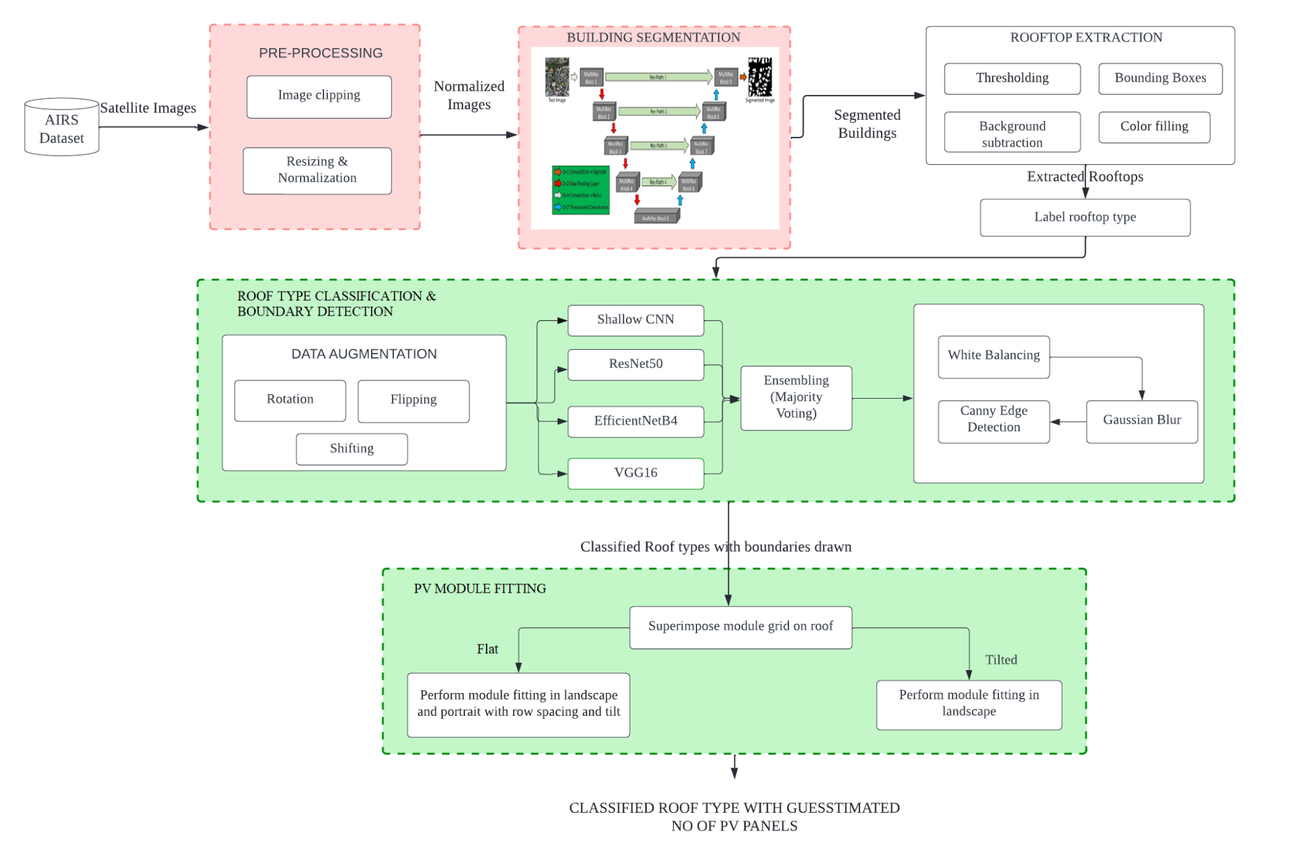
OVERALL ARCHITECTURE

Slide 11
OVERALL ARCHITECTURE
The pipeline consists of 3 modules: (i) Building segmentation and detection, (ii) Roof type classification and boundary detection, and (iii) PV module fitting.
The first module mainly emphasizes building detection and rooftop extraction from satellite images.
The first stage of building segmentation includes two pre-processing steps: clipping satellite images and the accompanying ground truth masks, followed by scaling and normalization.
The normalized images are then trained using the MultiRes UNet architecture for segmenting the buildings.
Image processing techniques like finding contours, drawing bounding boxes and background subtraction are performed to extract the rooftops of buildings.
Second module focuses on roof type classification and boundary detection.
We manually label the extracted rooftops into 3 classes: Flat, Gable, Hip which are fed to four different models and a comparative analysis is made.
Majority voting is used to combine predictions and improve classification accuracy.
Following that, edge detection of rooftops takes place to mark boundaries on rooftops.
The final module resorts to providing a simulation of modular layout of PV panels fitted on top of roofs.

Slide 12
LIST OF MODULES
MODULE 1: BUILDING DETECTION
MODULE II: ROOF TYPE CLASSIFICATION AND BOUNDARY DETECTION
MODULE III: MAXIMAL FITTING ALGORITHM

Slide 13
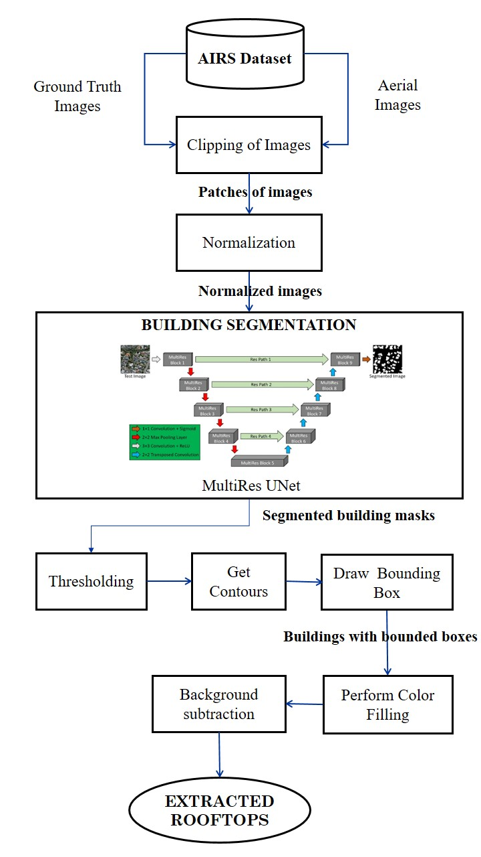
MODULE DESIGN
MODULE I: BUILDING DETECTION
INPUT: AIRS Dataset
OUTPUT: Rooftops of different buildings
The first step involves pre-processing with clipping of large aerial images into smaller tiles and performing resizing and normalization.
Input: Aerial images .
Output: Smaller patches of normalized images.
Following this, the MultiRes UNet architecture is implemented.
Input: Ground truth mask patches and aerial image patches for training.
Output: Trained model with binary mask for buildings
The final step involves background subtraction.
Input: Binary mask of buildings.
Output: Rooftops of different buildings.

Slide 14
PSEUDO-CODE
Begin
Pre-Processing
a. Get the original dimensions and the dimensions,
stride of smaller patches.
b. Find overlapping areas. overlapping := (size /
stride) - 1
c. for i in range (orig_shape / stride - overlapping):
d. Crop from i*stride:i*stride+size,
j*stride:j*stride+size
e. Perform resizing and normalization.
Training the MultiRes UNet Architecture
f. Split dataset into train - 1548 images, validation -
72 & testing - 144
g. Define the MultiRes model.
h. do:
i. Tweak hyperparameters: (lr, batch size, epochs,
optimizer, loss).
ii. Train the model.
iii. Plot graphs and check on validation data.
i. while (find the best model)
j. Save weights for the
best model.
Background Subtraction
k. Convert RGB to grayscale.
l . Find contours. m. Find the bounding box
coordinates := (x, y), (x+w, y), (x, y+h), (x+w, y+h)
n. Perform color filling.
o. Remove background from foreground
buildings.
End

Slide 15
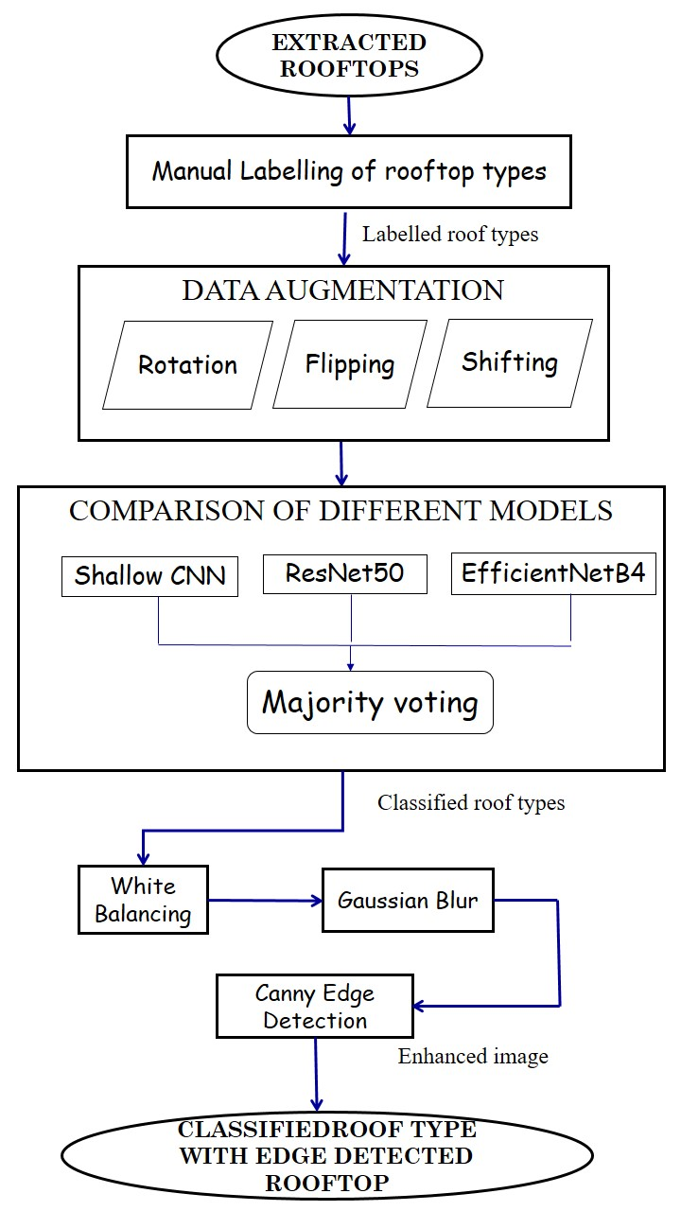
MODULE DESIGN
MODULE II: ROOF TYPE CLASSIFICATION & BOUNDARY DETECTION
INPUT: Extracted rooftops.
OUTPUT: Classified roof type with edge detected rooftop.
The first step is manually labeling the rooftops into 3 different classes - Flat, Gable, Hip.
This is followed by data augmentation with rotation, flipping and shifting as transformations.
Following this, we try 4 different models - customized CNN, ResNet50, EfficientNetB4 and VGG16 perform majority voting
Input: Rooftops with labels.
Output: Classified rooftop type.
The final step involves boundary detection performed by White Balancing, Gaussian blur and Canny edge detection.
Input: Classified rooftop type.
Output: Boundary detected rooftops.

Slide 16
PSEUDO-CODE
Begin
Data Augmentation
a. Rotation - Randomly generate an angle (theta)
and rotate the image by (theta) degrees
clockwise and anticlockwise.
b. Shifting - ImageDataGenerator
(width_shift_range = 0.10)
c. Flipping - ImageDataGenerator (horizontal_flip =
True)
Training different deep learning models
d. Split the dataset into train - 80%, validation - 10%
and testing- 10%.
e. Define a customized CNN model.
f. Train:
i. Tweak hyperparameters (Learning rate, batch
size, and optimizer).
h. Use pre-trained ResNet50, EfficientNetB4 and
VGG16.
i. Fine tune the pre-trained models.
j. Repeat above steps for the other 2 transfer
learning models.
j. Repeat above steps for the other 2 transfer
learning models.
k. For an unseen image:
i. Tweak hyperparameters (Learning rate,
batch size, and optimizer).
ii. Perform majority voting to identify the class
that gets the maximum votes.
Boundary Detection
l. White patching - Set a percentile score and remove
haze from the image.
m. Gaussian Blur - Try for different kernel size and 𝞼.
n. Find the threshold for adaptive canny edge
technique.
End

Slide 17
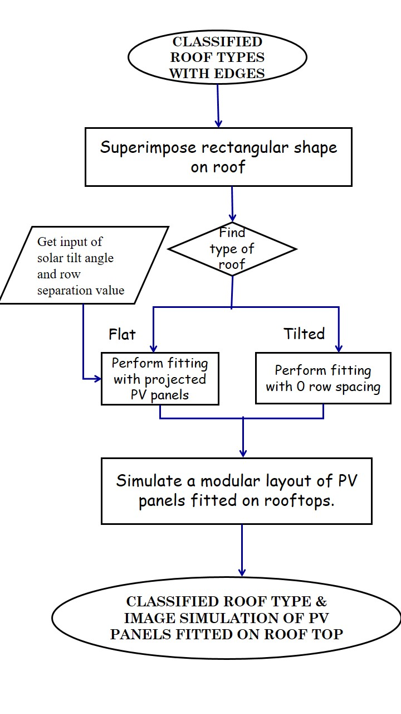
MODULE DESIGN
MODULE III: PV MODULE FITTING
INPUT: Classified roof type with edge detected rooftop .
OUTPUT: Classified roof type with simulation of PV panel on rooftops.
The boundary detected rooftops are superimposed with rectangular PV module shape.
Based on the type of roof:
For flat roofs: tilt angle in the range (20° - 50°) and row spacing is received from user and module fitting is performed.
For tilted roofs: tilt angle in the range (0° - 10°) with zero row spacing is used to perform module fitting.
An image of simulation with PV panels on top of roof is the final output.

Slide 18
PSEUDO-CODE
Begin
1. Get dimensions of PV panel from user (length, width, and spacing).
2. Get tilt angle based on the type of roof.
a. For flat roofs, tilt angle := (20° - 50°)
b. For tilted roofs, tilt angle := (0° - 10°)
3. Create a rectangular module grid according to the settings specified for flat and tilted roofs.
4. do:
I a. Identify new points after projecting the tilted PV panels.
(x', y') := (xcos - ysin, xsin + ycos)
b. Identify the contour area.
c. if area < 5:
Move to the next point as this area could be an obstacle or smaller patch unsuitable for panel placement.
else:
Fix a PV panel on the identified points.
d. if flat:
Shift the module grid with specified row spacing.
else:
Shift the module grid with 0 spacing.
e. Move to the next point on the line segment and fix panel over there.
while (entire roof top is analyzed)
End

Slide 19
IMPLEMENTATION
DATASET
AIRS dataset covering the full area of Christchurch in New Zealand with satellite images and ground truth masks.
Training set: 857 images
Validation Set: 90 images
Testing Set: 90 images
Spatial dimensions: 10000 ╳ 10000 pixels
Spatial resolution: 7.5 cm
EXPERIMENTAL SETUP
Tensorflow backend.
Keras Framework.
Environment used: Colab Pro with 16BG, T4 GPU and Kaggle GPU notebooks
Frontend integrated with flask.

Slide 20
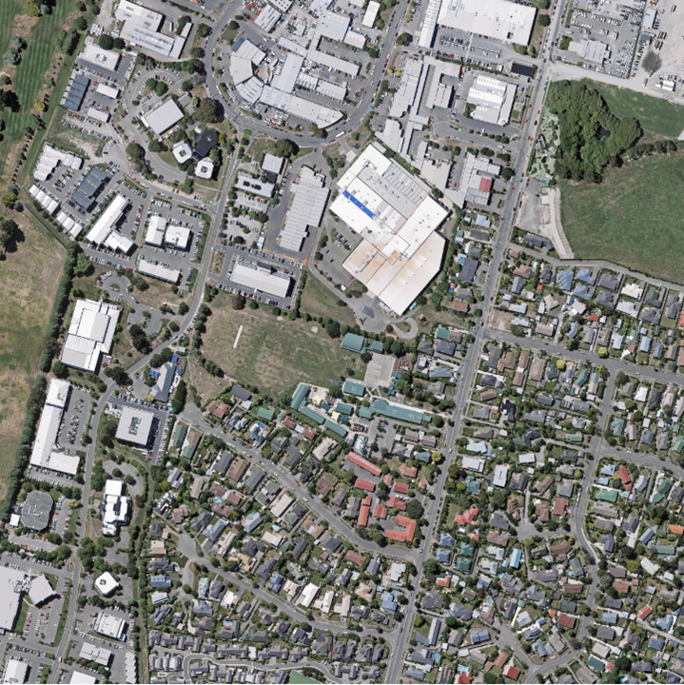
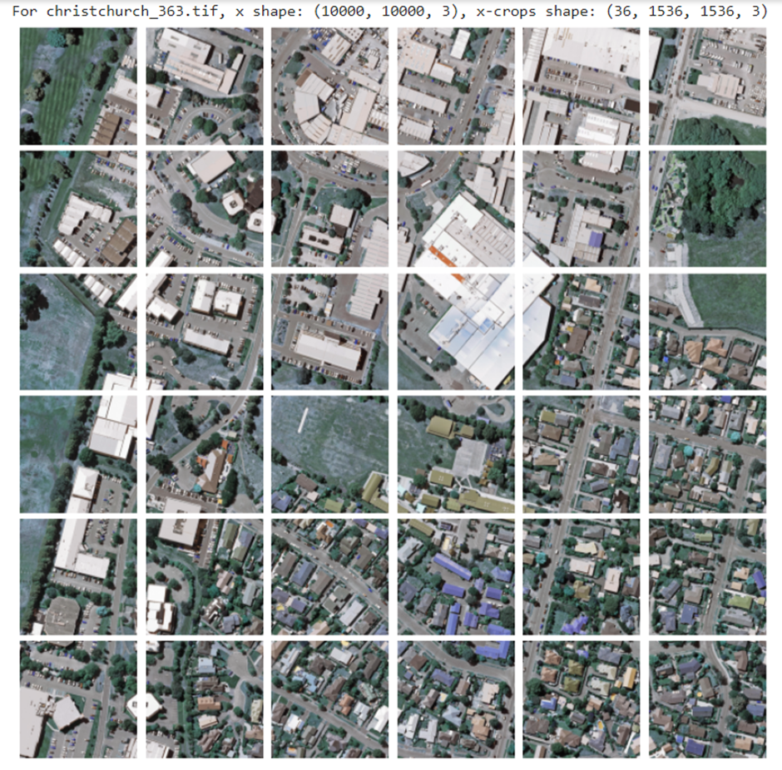
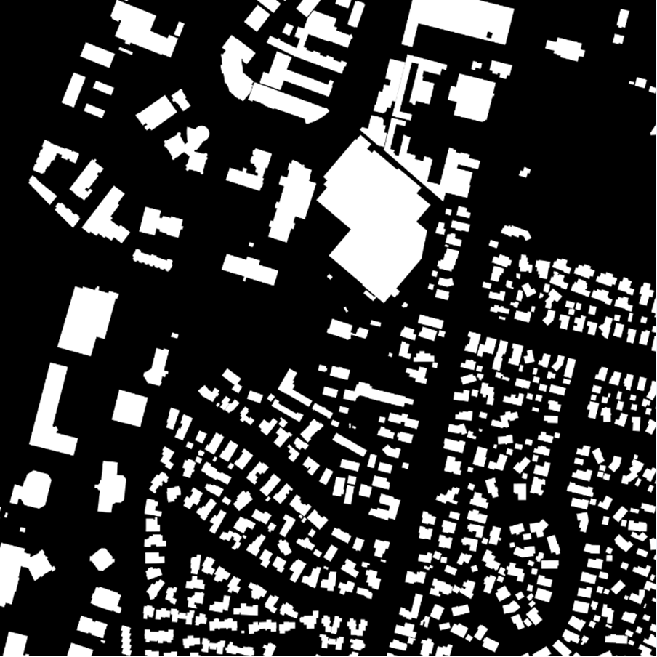
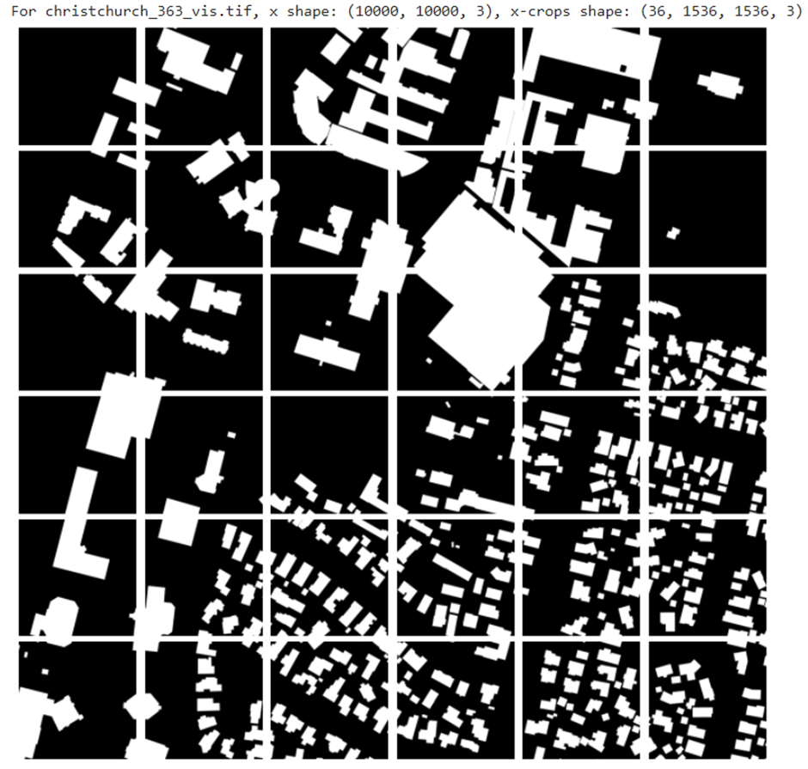
MODULE I - BUILDING DETECTION
1.1 Clipping original aerial images
Direct segmentation of large satellite images is difficult.
Dimensions of 10000 * 10000 pixels is cut into 36 smaller patches of size 1536 * 1536 by sliding window technique.
1.2 Clipping corresponding mask images
Corresponding ground truth masks for satellite images are also clipped.
Aerial satellite image
Patches of image after clipping
Ground truth segmented image
Ground truth patches after clipping

Slide 21
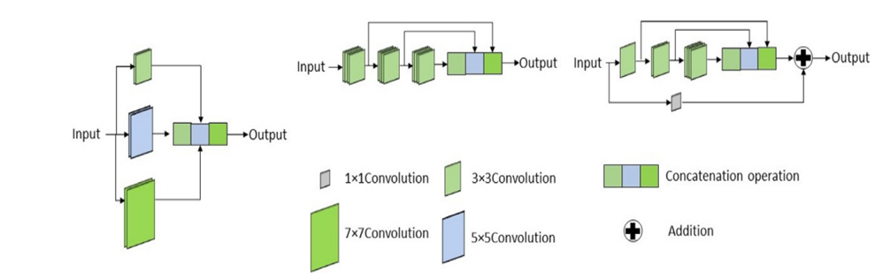
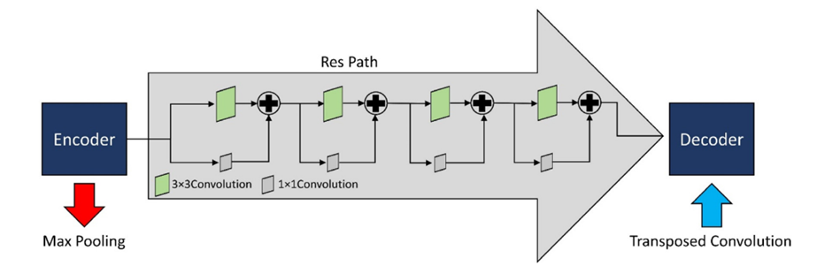
MODULE I - BUILDING DETECTION
1.3 Resizing and Normalization
Images of size 1536 * 1536 are difficult to train owing to hardware constraints. Images are hence resized to 256 * 256 with INTER_CUBIC interpolation method for better resolution of images.
1.4 Adapting the MultiRes UNet architecture
The architecture of the MultiRes UNet network consists of 2 important blocks: the MultiRes Block and the Res Path.
MultiRes Block
Res Path

Slide 22
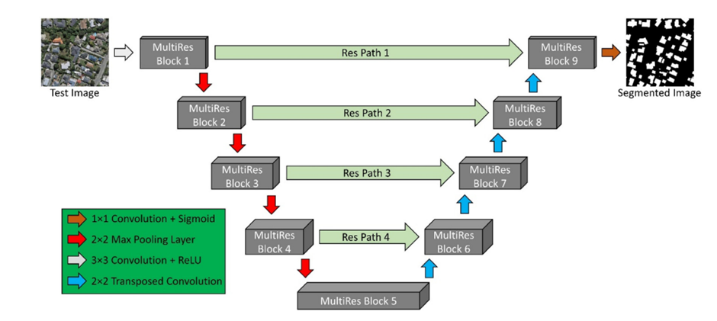
Architecture of MultiRes UNet
Hyper parameters | Values
Learning rate | 0.0001
Epochs | 100
Batch size | 8
Image dimensions | 256 x 256
Optimizer | Adam
Loss | Binary cross entropy
Activation Function | ReLU (in all convolution layers) Sigmoid (in the output layer)

Slide 23
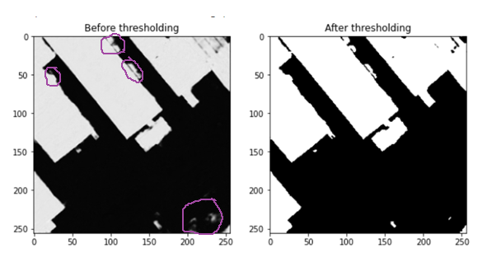
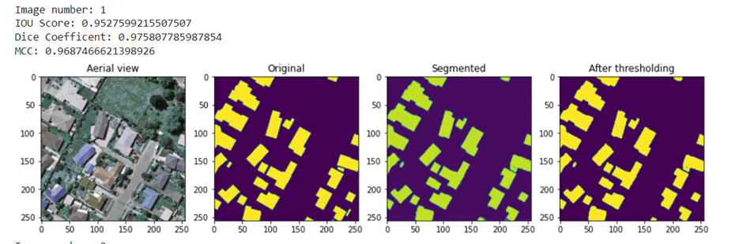
1.5 Applying threshold
Threshold is set to 0.5 to delineate the boundaries of buildings and differentiate the edges properly. The violet color markings show the difference before and after the threshold is applied.
Results of building segmentation before and after applying threshold.
Results of building segmentation with MultiRes UNet model

Slide 24
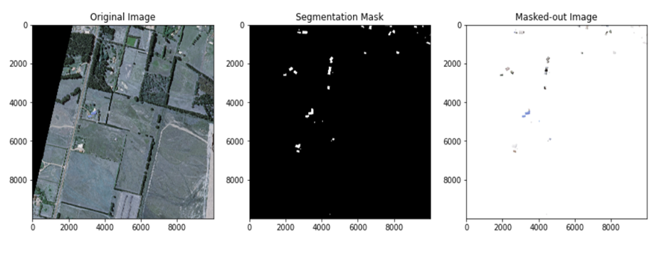
MODULE I - BUILDING DETECTION
1.6 Rooftop Extraction
1.6.1 Get contours
Contours are used to detect the borders of objects and localize them easily in an image.
Grayscale transformation and then binary thresholding is applied on it following which the contours of buildings are identified.
1.6.2 Drawing bounding box
Bounding boxes are used to highlight the regions of interest after obtaining
contours from an image.
1.6.3 Background Subtraction
Overlay segmentation mask on top of aerial satellite image.
Subtract bounded box segmented regions detected in earlier step with satellite image.
Original satellite image (left), masked image after training on MultiRes UNet model (center), extracted rooftops (right)

Slide 25
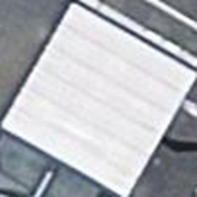
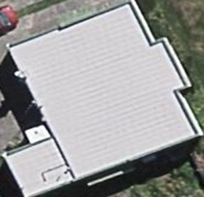
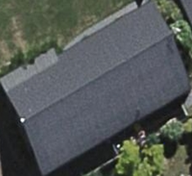
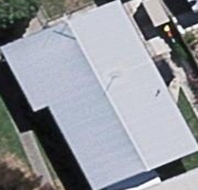
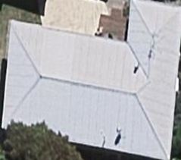
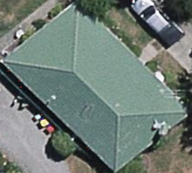
MODULE II - ROOF TYPE CLASSIFICATION AND BOUNDARY DETECTION
FLAT
GABLE
HIP
2.1 Preparation of dataset and labeling roof type
After conducting rooftop extraction in the preceding step, a dataset including 1115 rooftop photos is populated into three different categories: Flat, Gable, and Hip.
Manual labeling of dataset into 3 classes was performed.
Samples of images of each class from Christchurch, New Zealand

Slide 26
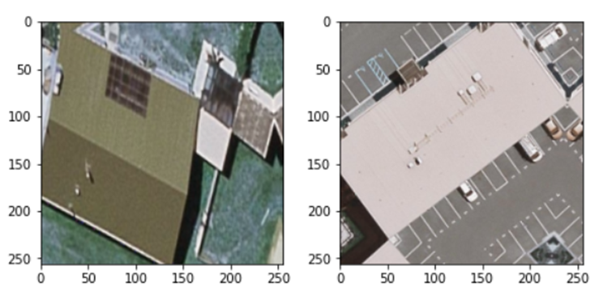
MODULE II - ROOF TYPE CLASSIFICATION AND BOUNDARY DETECTION
2.2 Data Augmentation
Data augmentation is applied to increase the dataset size for better model training.
Rotation, shifting and flipping are the three main techniques used here.
2.3 Roof type classification
Deep learning and transfer learning models are employed for roof type classification.
Shallow CNN
ResNet50
EfficientNetB4
VGG16
A comparative analysis of these models on the AIRS dataset is performed.
The model is validated with supervised roof type data from Potsdam.
To enhance the classification results, ensembling (majority voting) is used.
Results of image after performing data augmentation

Slide 27
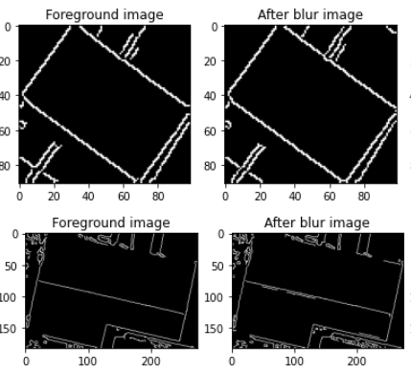
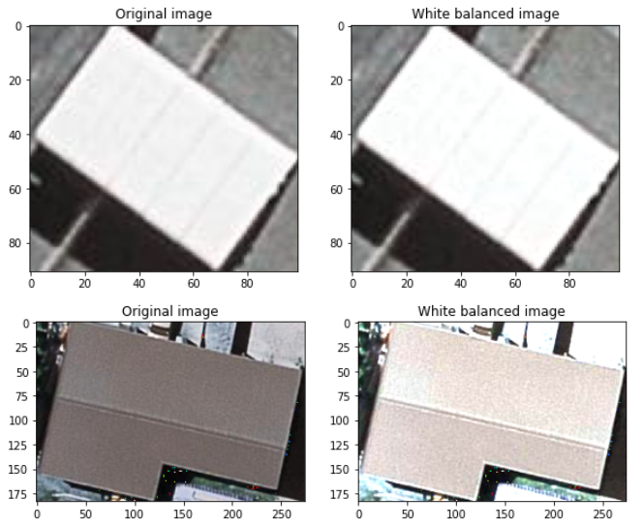
2.4 Boundary Detection
2.4.1 White Balancing
Satellite images are usually under highly variable lighting conditions which cause haze.
White balance is used to remove any coloured haze from an image so that it seems to be under white light.
2.4.2 Gaussian Blurring
Gaussian blurring reduces noise & accentuates edge contrast to identify boundaries on roof tops.
A kernel size of 3X3 is used with 𝞂= 1.5
2.4.3 Auto Canny Edge Detection
Multi-staged algorithm that includes noise reduction, finding intensity gradients and hysteresis suppression
The median of single channel pixel intensity is calculated.
The upper and lower threshold is calculated by using mean and variance of an image intensity.
White balanced image
Boundaries after performing edge detection

Slide 28
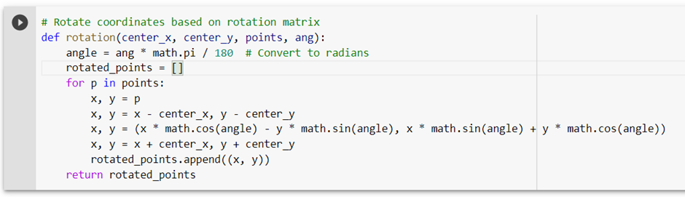
MODULE III - PV MODULE FITTING
3.1 Rotation of panels
PV panels that have zero tilt angle can be mounted directly on rooftops and moved.
For panels with non- zero tilt angle, projection of panels is necessary.
Let us assume the initial coordinates of PV panels to be (x,y).
Rotated coordinates (x', y') = (xcos𝛳 - ysin𝛳, xsin𝛳 + ycos𝛳).
Implementation of rotation of points
3.2 PV Panel Placement
Contours are drawn for identifying area.
All contour areas with size less than 5 are eliminated assuming them to be obstacles.
Otherwise, the rotated points are them checked to see if they lie within the boundary of rooftops.

Slide 29
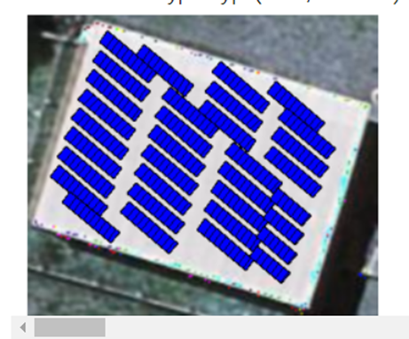
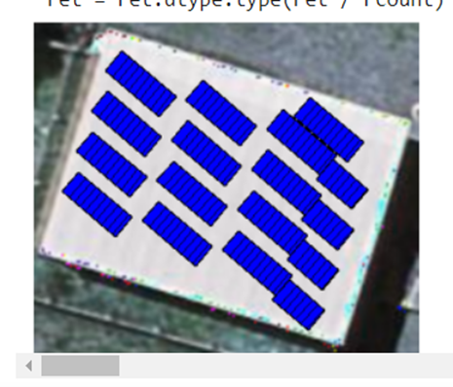
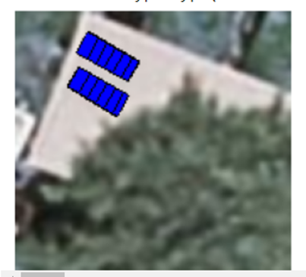
3.2 PV Panel Placement
For each of the rotated panels, pointpolygontest is undertaken to ensure that all points of solar PV panels lie inside the rooftop.
If the rotated panel coordinates lie outside, then the panels are not placed.
Bresenham's algorithm is used to identify points in straight line segments so that PV panels can be placed one after the other along the line segment.
This process is continued by going through the entire roof top area.
PV panels with dimensions length - 20mm; tilt angle - 40; width - 10 mm (left) and 20mm (right)
Placement of PV panels when there are obstacles

Slide 30
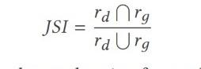
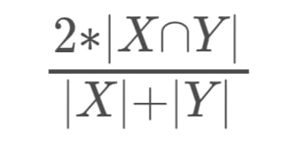
METRICS FOR EVALUATION
For building detection segmentation:
IoU - Intersection over Union /Jaccard Coefficient
To quantify the accuracy of our model for building detection, we use Jaccard coefficient which is to measure the similarity between detected regions and ground truth regions. Jaccard Similarity Index(JSI) measures the similarity for the two sets of pixel data, with a range from 0% to 100%. The higher the percentage, the more precise prediction. It is defined as follows:
where r_{d} denotes the masked region for building detection, and r_{g} indicates the groundtruth region for building segmentation.
DICE Coefficient
We use DICE coefficient to compare the pixel-wise agreement between a predicted segmentation and its corresponding ground truth. DICE coefficient is 2 times the area of overlap divided by the total number of pixels in both the images.The formula is given by:
where X is the predicted set of pixels and Y is the ground truth.

Slide 31
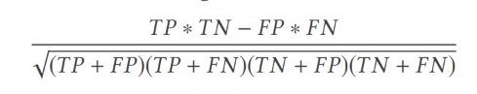
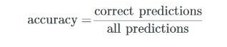
METRICS FOR EVALUATION
MCC - Matthews Correlation Coefficient
We use the MCC , a standard measure of a binary classifier’s performance, where values are in the range −1.0 to 1.0, with 1.0 being perfect building segmentation, 0.0 being random building segmentation, and −1.0 indicating building segmentation is always wrong.
Accuracy
Accuracy is the percentage of correct predictions for the test data. It can be calculated easily by dividing the number of correct predictions by the number of total predictions.
For roof type classification:
Classification Report
The classification report is used to measure the quality of predictions from a classification algorithm. Precision, Recall and F1 scores are calculated on a per-class basis based on True Positives, True Negatives, False Positives, False Negatives. Here, we calculate the above values for each of the classes, namely: Flat, Gable, Complex.

Slide 32
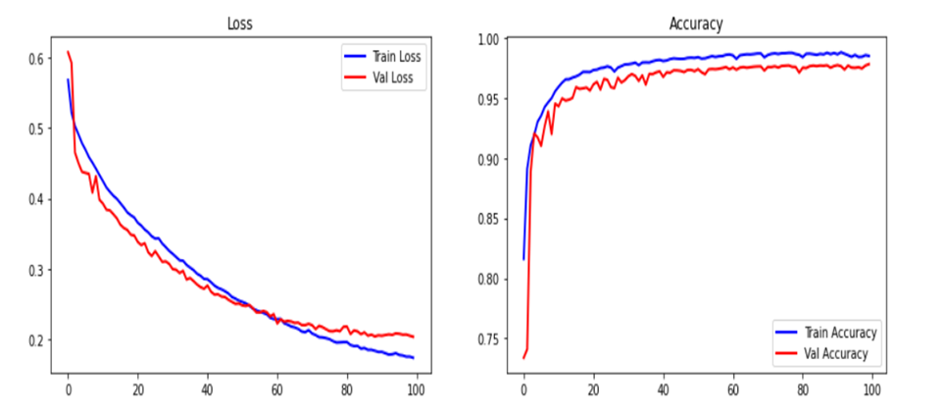
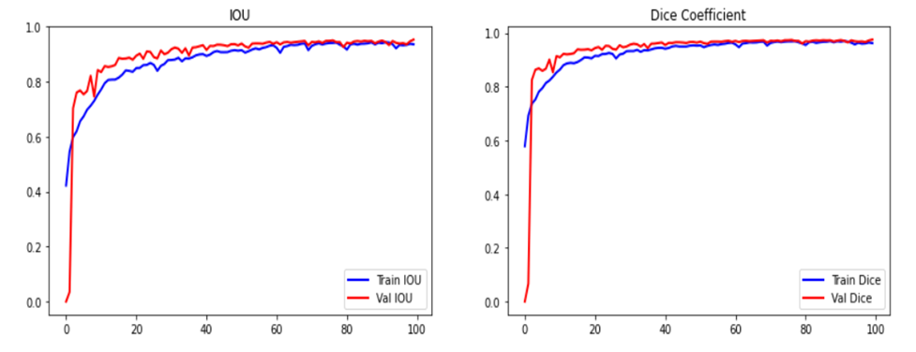
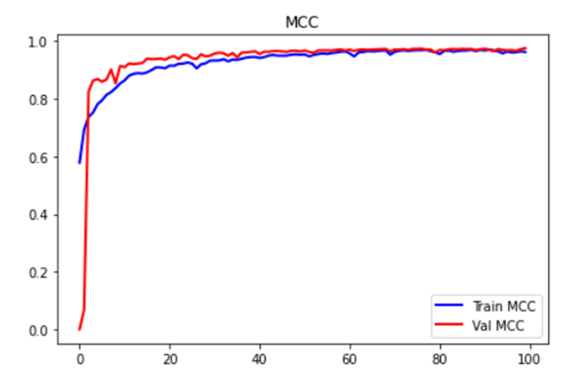
PERFORMANCE RESULTS FOR BUILDING SEGMENTATION
Performance metrics | Training Set | Validation Set
IOU (%) | 93.53 | 95.25
Dice Coefficient (%) | 96.25 | 97.56
MCC (%) | 95.87 | 96.74
Accuracy (%) | 98.51 | 97.83
Loss | 0.1734 | 0.2033
Model Loss
Model Accuracy
Performance results of the model on training and validation set
Model IOU
Model Dice Coefficient
Model MCC

Slide 33
PERFORMANCE INFERENCE FOR BUILDING SEGMENTATION
IoU, which penalizes heavily than dice coefficient, has achieved a value of 96.27% at the end of 100 epochs.
Average IoU after training 1548 images for 100 epochs comes to 93.53% and the validation IoU of 95.25% demonstrates that the model performs well even after the images are resized and normalized.
It can be seen that the Dice coefficient starts with 58% at the beginning of training and gradually attains a value of 98.5% with no major fluctuations.
Training and validation curve coincides with each other which indicates there is no overfitting.
The MCC value is close to 98% at the end of 100 epochs which indicates that buildings have been identified correctly.
The model has performed remarkably well as the training loss hovers around 0.173 and validation loss is close to 0.2. This is a reasonably good value which indicates that our model performs well in segmenting the buildings accurately.

Slide 34
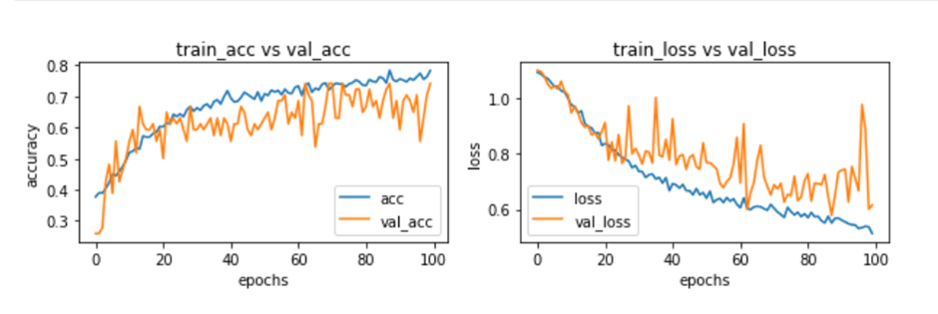
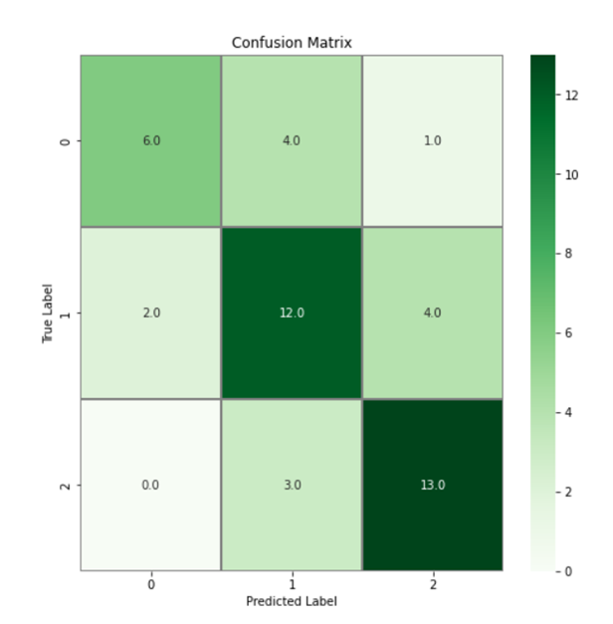
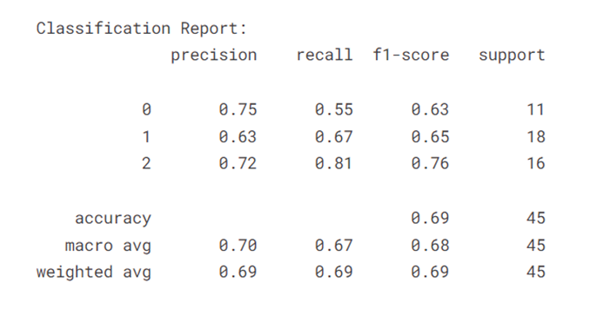
CLASSIFICATION RESULTS FOR CNN MODEL
The CNN model achieved an accuracy of 78% on the training set and 74% on the validation set.
Graphs showing the training and validation accuracy and loss for CNN model
The confusion matrix reveals that gable and hip classes are accurately classified to a larger extent.
Hip class has the highest recall value of 81% followed by gable 62 (67%) and then flat (55%).
Confusion matrix and classification report on test data for CNN model

Slide 35
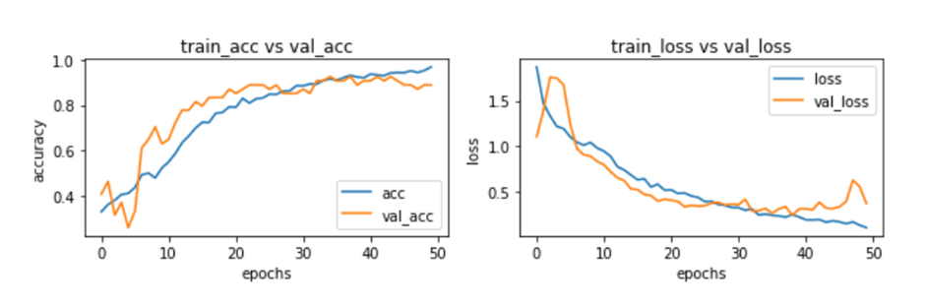
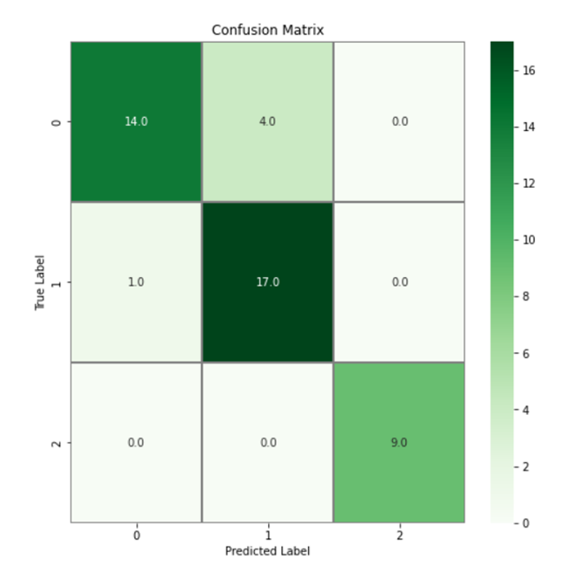
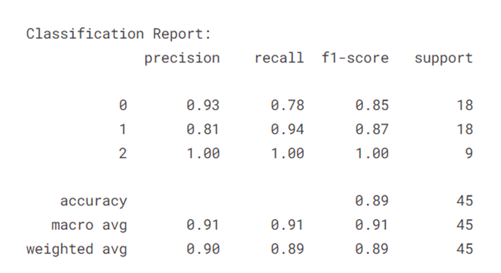
CLASSIFICATION RESULTS FOR RESNET-50 MODEL
The ResNet-50 has yielded an accuracy of 91.59% on the training set and 92.5% on the validation set.
The loss is also very less at only 0.245 on the training set.
Graphs showing the training and validation accuracy and loss for ResNet50
Hip class is 100 % accurately classified.
The classification of flat classes is better compared to the previous CNN model.
The overall accuracy on the test samples is 89% with F-1 score averaging to 91%.
Confusion matrix and classification report on test data for ResNet-50 model

Slide 36
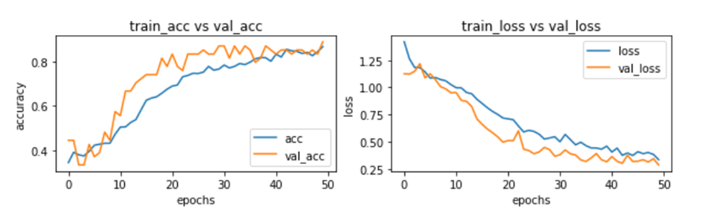
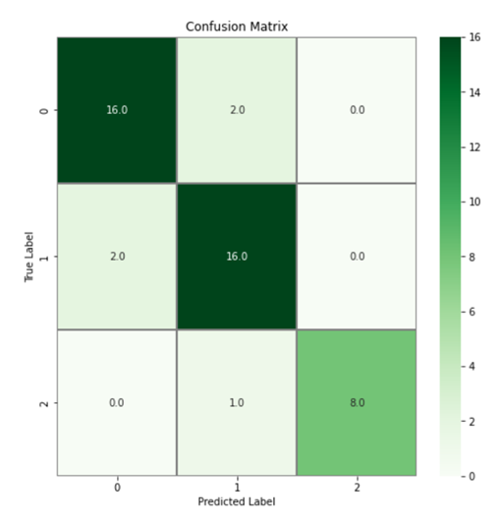
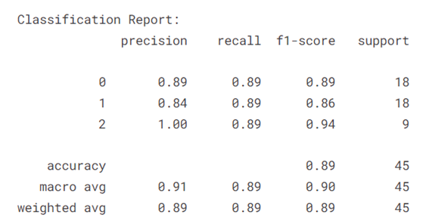
CLASSIFICATION RESULTS FOR EFFICIENTNETB4 MODEL
The graphs exhibits that the accuracy of the model has steadily grown from 40% to 89% and the model loss has significantly reduced from 1.25 to 0.33 at the end of 50 epochs.
Graphs showing the training and validation accuracy and loss for EfficientNetB4
When compared with the ResNet50 model which had higher accuracy in correctly classifying hip class, EfficientNetB4 model has achieved higher F-1 score and accuracy in identifying flat roof tops.
The average F1 score, precision, and recall hover around 91%.
Confusion matrix and classification report on test data for EfficientNetB4

Slide 37
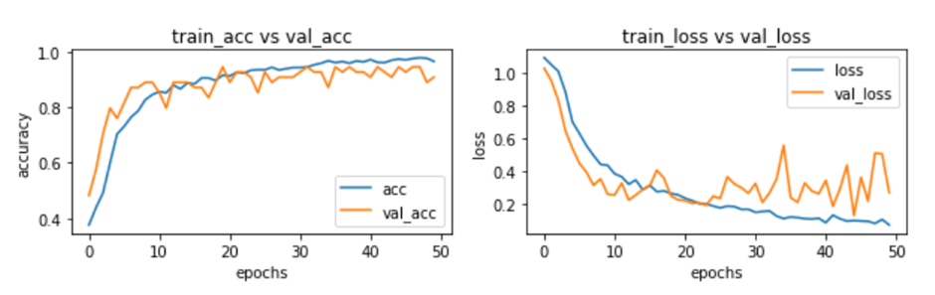
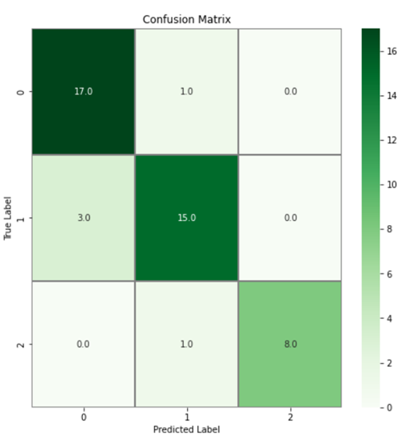
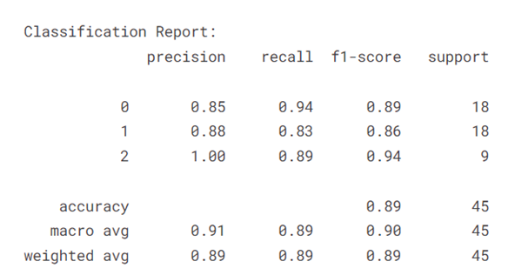
CLASSIFICATION RESULTS FOR VGG16 MODEL
VGG-16 model has achieved the highest accuracy compared to the other three models.
The classification accuracy on the validation set is 94.45% while the training accuracy is around 97%.
Graphs showing the training and validation accuracy and loss for VGG-16
The F-1 score for flat class is the highest with VGG16 compared to other models.
The overall classification accuracy has totalled to 89%.
Confusion matrix and classification report on test data for VGG-16 model

Slide 38
COMPARISON OF RESULTS WITH DIFFERENT MODELS
Model | Learning rate & Optimizer | Batch size | Loss | Accuracy (%) | F-1 score
Shallow CNN | 0.0001 & RMSProp | 16 | 0.7233 - Train 0.8067 - Test | 79.25 - Train 69.8 - Test | 0.69
ResNet- 50 | 0.00001 & RMSProp | 8 | 0.2450 - Train 0.7123 - Test | 92.59 - Train 88.89 - Test | 0.91
EfficientNetB4 | 0.00001 & Adam | 16 | 0.3359 - Train 0.343 - Test | 86.70 - Train 89 - Test | 0.91
VGG16 | 0.0001 & RMSProp | 4 | 0.2021 - Train 0.4894 - Test | 96.5 - Train 88.89 - Test | 0.89
Results of different classification models on AIRS dataset

Slide 39
VALIDATION OF MODELS ON POTSDAM DATASET
Model | Learning rate & Optimizer | Batch Size | Loss | Accuracy (%) | F-1 score
Shallow CNN | 0.0001 & RMSProp | 16 | 1.2829 | 45.67 | 0.38
ResNet- 50 | 0.00001 & RMSProp | 8 | 0.9248 | 70.67 | 0.71
EfficientNetB4 | 0.00001 & Adam | 16 | 0.7110 | 65.17 | 0.66
VGG16 | 0.0001 & RMSProp | 4 | 0.8507 | 74 | 0.73
Results of testing our trained models on Potsdam dataset

Slide 40
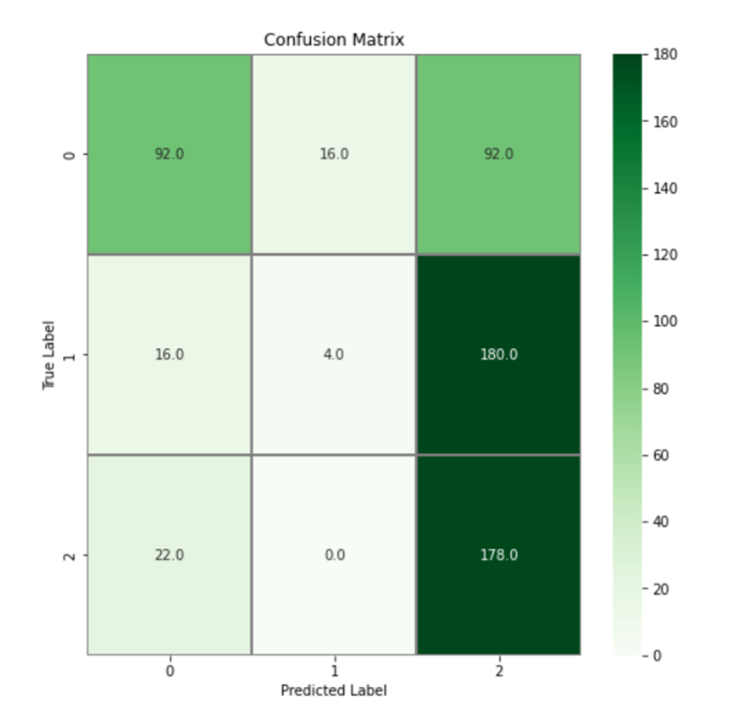
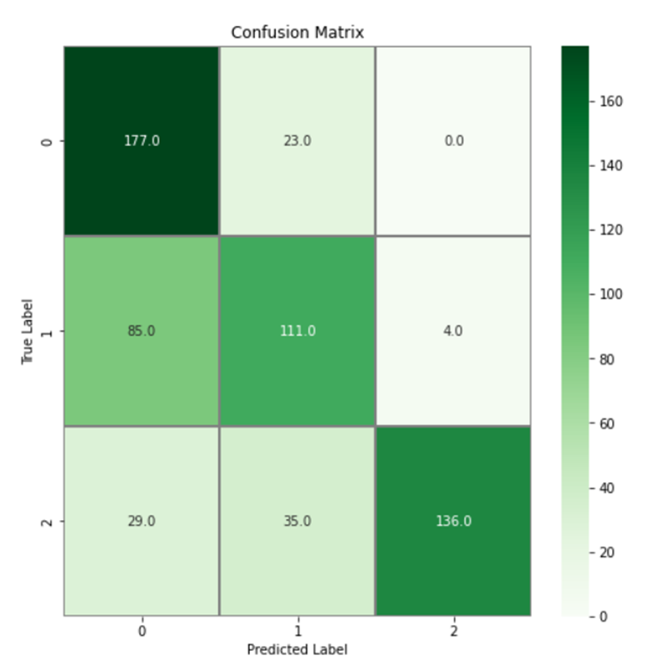
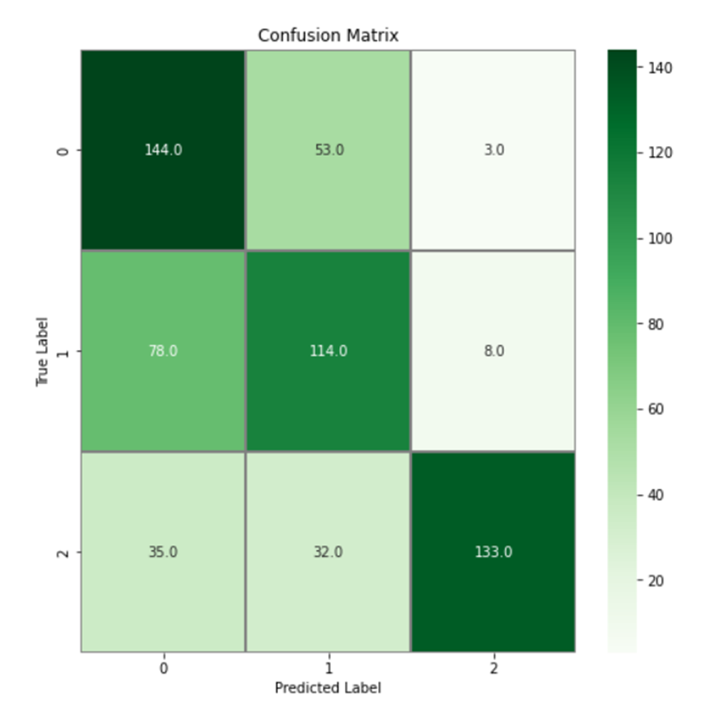
VALIDATION OF MODELS ON POTSDAM DATASET
ResNet50
EfficientNetB4
Shallow CNN

Slide 41
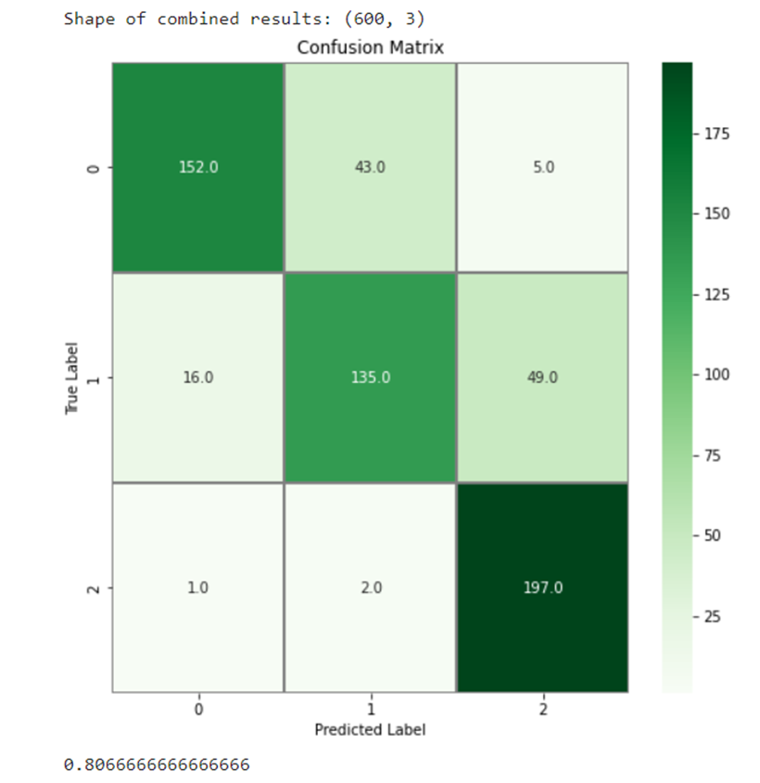

VALIDATION OF MODELS ON POTSDAM DATASET
Majority Voting
VGG16

Slide 42
COMPARATIVE ANALYSIS
 | MultiRes baseline | MultiRes with normalization
IoU (%) | 93.14 | 95.25
MCC (%) | 94.91 | 96.74
Dice coefficient (%) | 96.45 | 97.56
Comparative analysis between the baseline model and our proposed MultiRes with normalization.
Model | Results on AIRS dataset |  |  | Results on Ankara, Turkey dataset
 | Precision | Recall | F1 score | Precision | Recall | F1 score
Shallow CNN | 70 | 67.67 | 68 | 81 | 81.67 | 81
ResNet50 | 91.34 | 90.67 | 90.67 | 82.34 | 86.34 | 84.34
EfficientNetB4 | 91 | 89 | 89.67 | 81 | 84 | 82.34
VGG16 | 91 | 88.67 | 89.67 | 84.67 | 89.67 | 86.67
Comparative analysis of different DL models on AIRS dataset and dataset from Ankara, Turkey

Slide 43


TEST CASES
TEST CASE ID | TEST CASE DESCRIPTION | TEST INPUT | TEST OUTPUT
TC_01 | Applying Threshold
TC_02 | Building segmentation results- with no buildings.

Slide 44




TEST CASES
TEST CASE ID | TEST CASE DESCRIPTION | TEST INPUT | TEST OUTPUT
TC_03 | Building segmentation of a single building.
TC_04 | Building segmentation of various buildings in a single image.

Slide 45


TEST CASES
TEST CASE ID | TEST CASE DESCRIPTION | TEST INPUT | TEST OUTPUT
TC_05 | Classification of Gable image |  | ResNet50 - 1 (Gable) Shallow CNN - 1 (Gable) EfficientNetB4 - 1 (Gable) VGG16 - 1 (Gable)
TC_06 | Classification of flat image |  | ResNet50 - 0 (Flat) Shallow CNN - 1 (Gable) EfficientNetB4 - 0 (Flat) VGG16 - 0 (Flat)

Slide 46



TEST CASES
TEST CASE ID | TEST CASE DESCRIPTION | TEST INPUT | TEST OUTPUT
TC_07 | Classification of hip image |  | ResNet50 - 2 (Hip) Shallow CNN - 2 (Hip) EfficientNetB4 - 2 (Hip) VGG16 - 2 (Hip)
TC_08 | Majority Voting (Unequal predictions) |  | 3 models predict as Gable while 1 model predicts as Flat

Slide 47




TEST CASES
TEST CASE ID | TEST CASE DESCRIPTION | TEST INPUT | TEST OUTPUT
TC_09 | Majority Voting (Equal predictions) |  | All models predict as class hip
TC_10 | Auto Canny Edge detection

Slide 48
TEST CASES
TEST CASE ID | TEST CASE DESCRIPTION | TEST INPUT | TEST OUTPUT
TC_11 | PV Panel placement for flat roof | Roof type: Flat Length: 20mm Width: 10 mm Tilt Angle: 40
TC_12 | PV Panel placement for flat roof with different width | Roof type: Flat Length: 20mm Width: 20 mm Tilt Angle: 40

Slide 49


TEST CASES
TEST CASE ID | TEST CASE DESCRIPTION | TEST INPUT | TEST OUTPUT
TC_13 | PV Panel placement for flat roof with varying tilt angle | Roof type: Flat Length: 20mm Width: 20 mm Tilt Angle: 30
TC_14 | PV Panel placement for gable roof with tree as obstacle | Roof type: Gable Length: 20mm Width: 20 mm Tilt Angle: 10

Slide 50
TEST CASES
TEST CASE ID | TEST CASE DESCRIPTION | TEST INPUT | TEST OUTPUT
TC_15 | PV Panel placement for flat roof with tree as obstacle | Roof type: Flat Length: 10mm Width: 10 mm Tilt Angle: 30

Slide 51
CONCLUSION
A 3-step pipeline was proposed in this research to automate the process of PV panel placement on rooftops given a satellite image covering a wide range and different types of buildings.
The first phase involved building segmentation on AIRS dataset with the MultiRes UNet model that utilizes MultiRes block to adapt spatial features from various scales and Res path for transferring encoder features to decoder features using a set of convolution operations.
Experiment results shows that proper segmentation of buildings led to proper extraction of different roof types which were manually categorized into 3 classes: Flat, Gable and Hip.
We discovered that different models performed well in classifying different classes of roof tops with ResNet performing well in identifying flat roofs, EfficientNetB4 in classifying gable roof tops and VGG16 with hip roofs and hence majority voting was used as an ensembling technique in combining the predictions of different learning models.
The final output classifies the type of roof into one of flat, gable or hip and simulates the modular layout fitting of PV panels on top of roofs considering the type of roof, tilt angle, length and width of roof types.

Slide 52
REFERENCES
[1] Abdollahi, A., Pradhan, B., Gite, S., & Alamri, A. (2020). Building footprint extraction from high resolution aerial images using generative adversarial network (GAN) architecture. IEEE Access, Article 209517-209527. http://dx.doi.org/10. 1109/ACCESS.2020.3038225.
[2] Axelsson, M., Soderman, U., Berg, A. and Lithen, T., 2018, April. Roof Type Classification Using Deep Convolutional Neural Networks on Low Resolution Photogrammetric Point Clouds from Aerial Imagery. In 2018 IEEE International Conference on Acoustics, Speech and Signal Processing (ICASSP)(pp.1293-1297).IEEE, https://doi.org/10.1109/ICASSP.2018.846.
[3] Badrinarayanan, V., Kendall, A., & Cipolla, R. (2017). Segnet: A deep convolutional encoder–decoder architecture for image segmentation. IEEE Transactions on Pattern Analysis Machine Intelligence, 39, 2481–2495.
[4] B. Chatterjee and C. Poullis, "On Building Classification from Remote Sensor Imagery Using Deep Neural Networks and the Relation Between Classification and Reconstruction Accuracy Using Border Localization as Proxy," (2019) 16th Conference on Computer and Robot Vision (CRV), 2019, pp. 41-48, doi: 10.1109/CRV.2019.00014.
[5] Buyukdemircioglu, Mehmet & Can, Recep & Kocaman, Sultan (2021)Deep learning based roof type classification using VHR aerial imagery, The International Archives of the Photogrammetry, Remote Sensing and Spatial Information Sciences. XLIII-B3-2021. 55-60. 10.5194/isprs-archives-XLIIIB3-2021-55-2021.
[6] Chen, Mengge and Jonathan Li. (2019) “Deep convolutional neural network application on rooftop detection for aerial image.” ArXiv abs/1910.13509.
[7] Edun, Ayobami & Harley, Joel & Deline, Chris & Perry, Kirsten. (2021). Unsupervised azimuth estimation of solar arrays in low-resolution satellite imagery through semantic segmentation and Hough transform. Applied Energy. 298. 10.1016/j.apenergy.2021.117273.

Slide 53
REFERENCES
[8] Jordan M Malof, Rui Hou, Leslie M Collins, Kyle Bradbury, and Richard Newell. 2015. Automatic solar photovoltaic panel detection in satellite imagery. In 2015 International Conference on Renewable Energy Research and Applications (ICRERA). IEEE, 1428–1431.
[9] Kumar, Akash & Sreedevi, Indu. (2018). Solar Potential Analysis of Rooftops Using Satellite Imagery. ArXiv abs/1812.11606.
[10] Nahid Mohajeri, Dan Assouline, Berenice Guiboud, Andreas Bill, Agust Gudmundsson, Jean-Louis Scartezzini, (2018). A city-scale roof shape classification using machine learning for solar energy applications, Renewable Energy Volume 121. Pages 81-93. ISSN 0960-1481. doi:10.1016/j.renene.2017.12.096.
[11] Peiran Li, Haoran Zhang, Zhiling Guo, Suxing Lyu, Jinyu Chen, Wenjing Li, Xuan Song, Ryosuke Shibasaki, Jinyue Yan. (2021). Understanding rooftop PV panel semantic segmentation of satellite and aerial images for better using machine learning. Advances in Applied Energy, Elsevier. Volume 4, 100057, ISSN 2666-7924. doi: 10.1016/j.adapen.2021.100057.
[12] Qi, Chen & Wang, Lei & Wu, Yifan & Wu, Guangming & Guo, Zhiling & Waslander, Steven. (2018). Aerial Imagery for Roof Segmentation: A Large-Scale Dataset towards Automatic Mapping of Buildings. ISPRS Journal of Photogrammetry and Remote Sensing, Elsevier. Volume 147, pp. 42-55.
[13] Q. Li, Y. Feng, Y. Leng and D. Chen, " SolarFinder: Automatic Detection of Solar Photovoltaic Arrays," (2020) 19th ACM/IEEE International Conference on Information Processing in Sensor Networks (IPSN), 2020, pp. 193-204, doi: 10.1109/IPSN48710.2020.00024.
[14] V. Golovko, S. Bezobrazov, A. Kroshchanka, A. Sachenko, M. Komar and A. Karachka, (2017), "Convolutional neural network based solar photovoltaic panel detection in satellite photos," 9th IEEE International Conference on Intelligent Data Acquisition and Advanced Computing Systems: Technology and Applications (IDAACS), pp. 14-19, doi: 10.1109/IDAACS.2017.8094501.
[15] X. Li, Y. Jiang, H. Peng and S. Yin, (2019), "An aerial image segmentation approach based on enhanced multi-scale convolutional neural network," IEEE International Conference on Industrial Cyber Physical Systems (ICPS), pp. 47-52, doi: 10.1109/ICPHYS.2019.8780187.

Slide 54
THANK YOU

Slide 55



Slide 56



Slide 57



POTSDAM SAMPLE IMAGES

Slide 58



Slide 59



Slide 60



Slide 61



